Slide 1
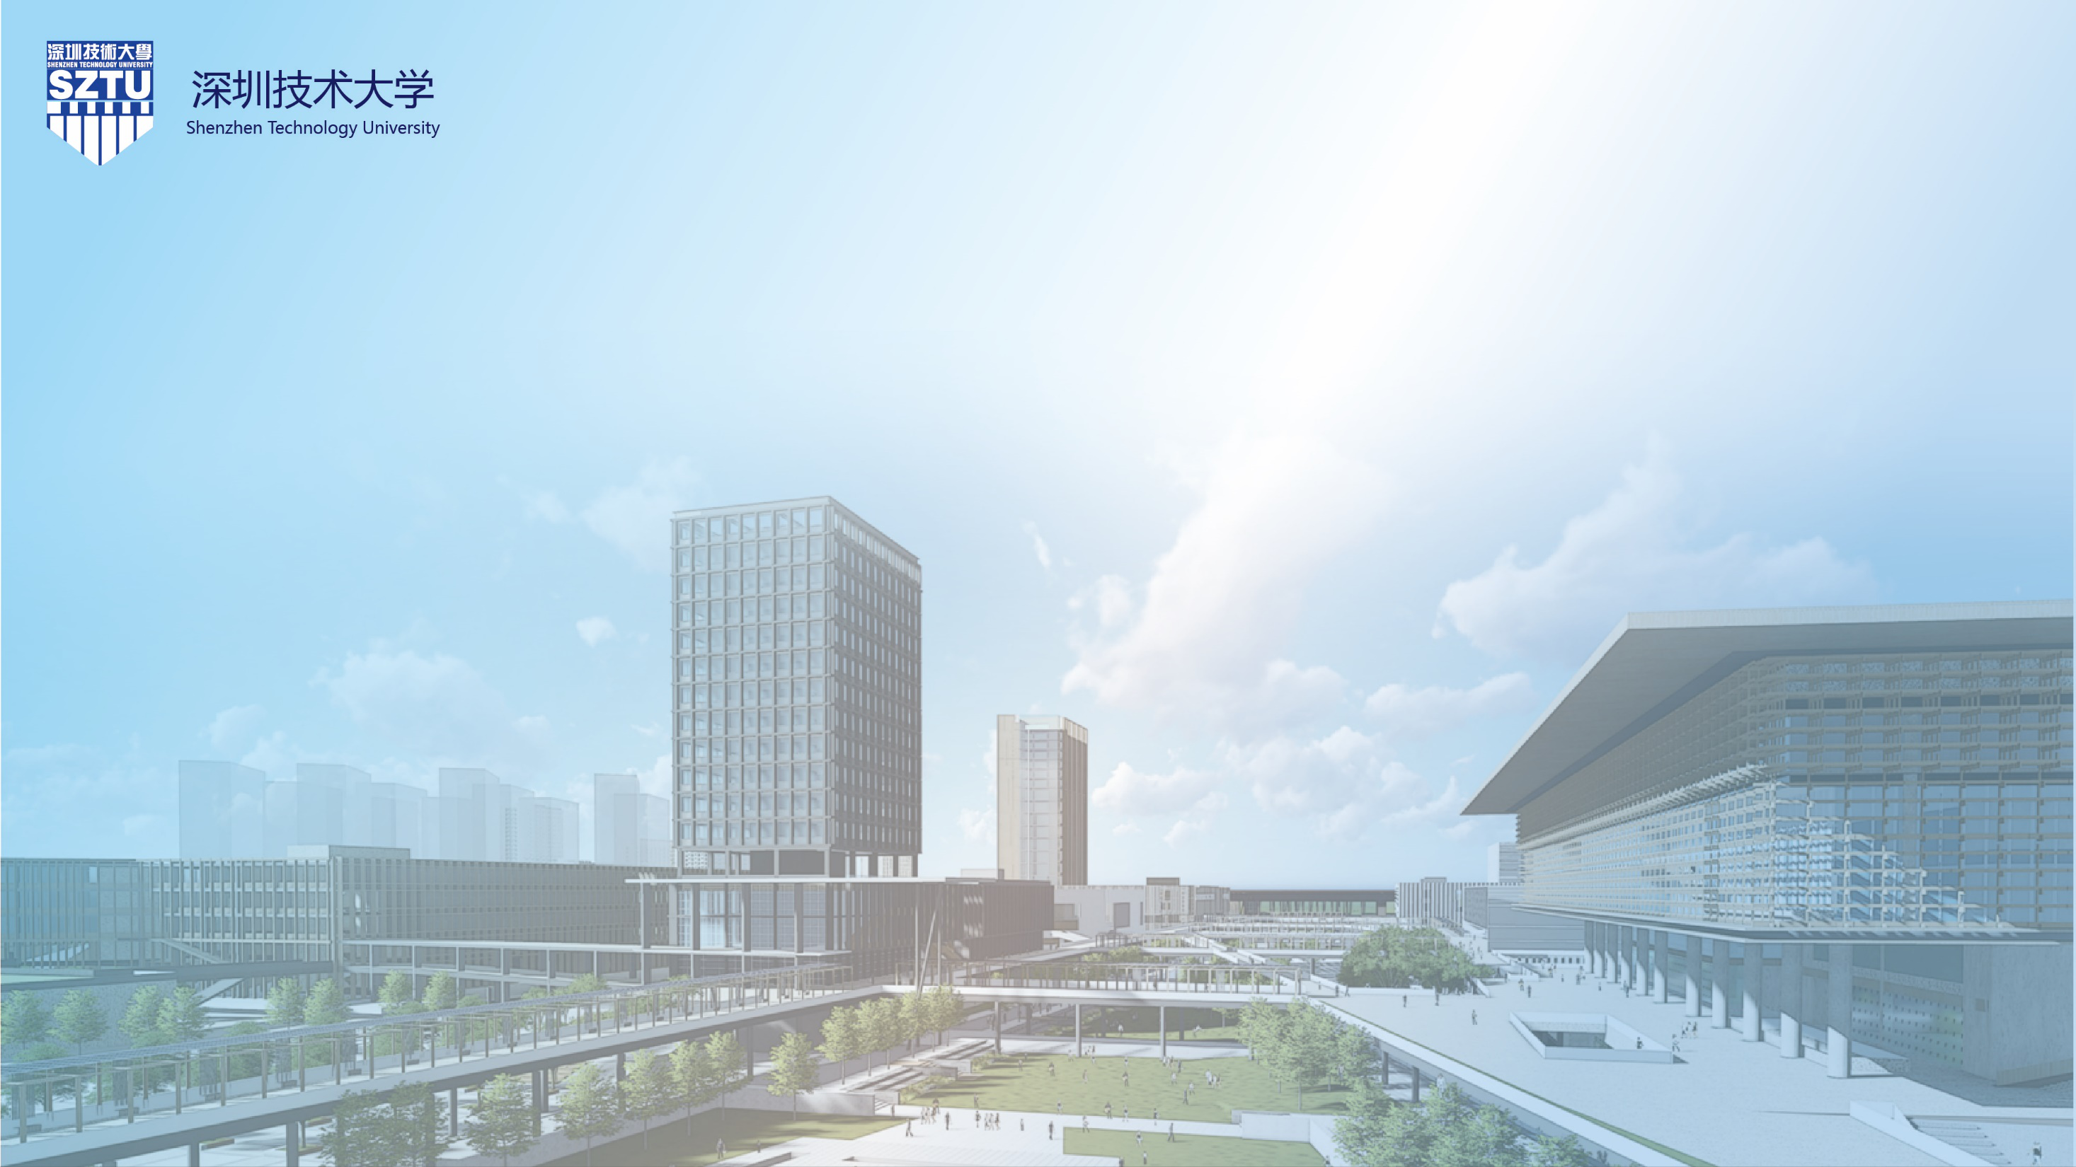
深圳技术大学（筹）科技创新计划介绍
Introduction of Shenzhen Technology University (SZTU) Science and Technology Innovation Program

Slide 2
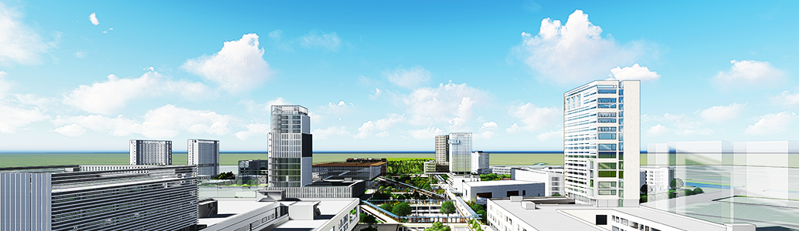
学校简介 Overview of SZTU
深圳技术大学是深圳市人民政府设立的公办普通高等学校，致力于建设成为世界一流的高水平、国际化、应用型技术大学。学校以工科为主，紧密结合产业需求，培养本科及以上层次具有国际视野、工匠精神和创新创业能力的高水平工程师、设计师等高素质应用型人才。
Established by the Municipal Government of Shenzhen as a public institution of higher education and with the focus on the needs of industries, Shenzhen Technology University (SZTU) engages itself in building a world-class and international university of applied sciences. SZTU gives priority to engineering courses, aiming to cultivate high-quality applied talents, such as high-quality engineers and designers with an international vision, craftsman’s spirit and strong innovation capacity.

Slide 3
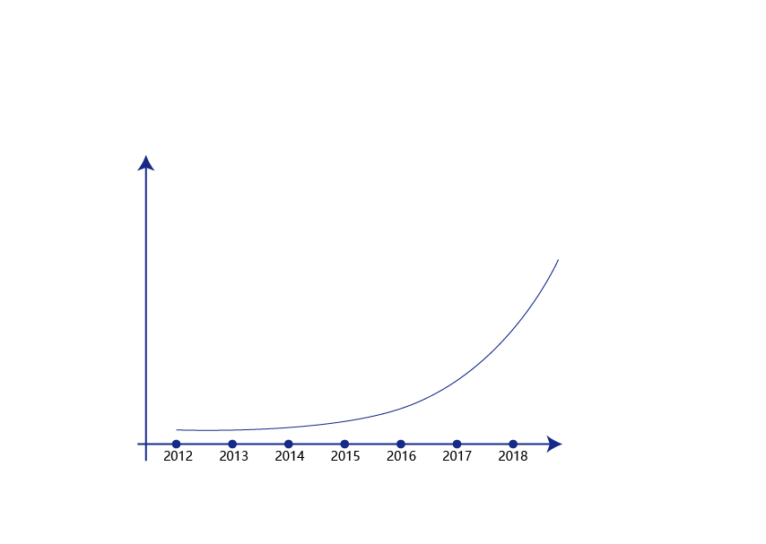
学校简介 Overview of SZTU
2017年，学校先期依托深圳大学建设中德智能制造学院、新能源与新材料学院、大数据与互联网学院、健康与环境工程学院、城市交通与物流学院、创业设计学院 6大学院。
2017年7月，学校依托深圳大学首批在中德智能制造学院、新能源与新材料学院、大数据与互联网学院招收226名本科学生；
2018年7月，学校依托深圳大学在6大学院招收807人。
In 2017, supported by Shenzhen Technology University, SZTU set up six colleges, including the Sino-German College of Intelligent Manufacturing, College of Big Data and Internet, College of New Materials and New Energies, College of Urban Transportation and Logistics, College of Creative Design, and College of Health Science and Environmental Engineering.
In July 2017, supported by Shenzhen University, SZTU admitted 226 undergraduates to Sino-German College of Intelligent Manufacturing, College of Big Data and Internet, College of New Materials and New Energies.
In July 2018, SZTU admitted 807 undergraduates with the support of Shenzhen University.
筹建进程
Process of Establishment
招生
Students
Enrollment

Slide 4
学校简介 Overview of SZTU
学院 Colleges | 2017-2019年设置专业 Majors 2017-2019 | 对接产业及应用方向 Relevant Directions
中德智能制造学院 Sino-German College of Intelligent Manufacturing | 机械设计制造及其自动化（智能制造、机器人） Mechanical Design, Manufacturing and Automation（Intelligent Manufacturing，Robotics） 自动化（3D技术） Automation（3D Techic） 光电信息科学与工程（光电检测与激光制造技术） Photoelectric Information Science and Engineering （Photoelectric Detection and Laser Manufacturing Technology） | 高端制造产业、机器人、可穿戴装备、 智能装备产业、航空航天产业 High-end Manufacturing Industry, Robotic, Wearable Equipment, Intelligent Equipment Industry, Aerospace Industry
大数据与互联网学院 College of Big Data and Internet | 物联网工程（Internet of Things） 电子科学与技术（Electronic Science and Technology ） 软件工程（互联网与大数据） Software Engineering (Internet and Big Data) | 新一代信息技术产业、互联网通信产业 A New Generation of Information Technology Industry, Internet Communication Industry
城市交通与物流学院 College of Urban Transportation and Logistics | 交通运输（城市轨道交通） Transportation （Urban Rail Transportation） 汽车服务工程（清洁能源汽车） Automobile Service Engineering（Clean-Energy Automobile） 物流管理（供应链）Logistics management (Supply Chain) | 轨道交通产业、清洁能源汽车产业 Rail Transportation Industry, Clean-Energy Automobile Industry
新材料与新能源学院 College of New Materials and New Energies | 光源与照明 Illuminating Source and Illumination 新能源科学与工程（新能源器件与应用） New Energy Science and Engineering（New Energy Devices and Applications） | 清洁能源产业、新材料产业 Clean-Energy Industry, New Materials Industry
健康与环境工程学院 College of Health Science and Environmental Engineering | 生物医学工程（智能医学设备） Biomedical Engineering (Intelligent Medical Equipment) | 生物产业、健康产业 Biological Industry, Health Industry
创意设计学院 College of Creative Design | 工业设计（Industrial Design） | 艺术设计、经济艺术产业 Art Design, Economic Art Industry

Slide 5
学校简介 Overview of SZTU
2018年，本科在校生1100人
2020年，本科在校生5000人
2025年，在校生规模达到2.5万人,其中:
本科生1.9万人
专业学位硕士研究生3000人
留学生3000人
In 2018, 1100 undergraduates
In 2020, 5000 undergraduates
In 2025, 25000 students, including:
19000 undergraduates
3000 post-graduates
3000 overseas students

Slide 6
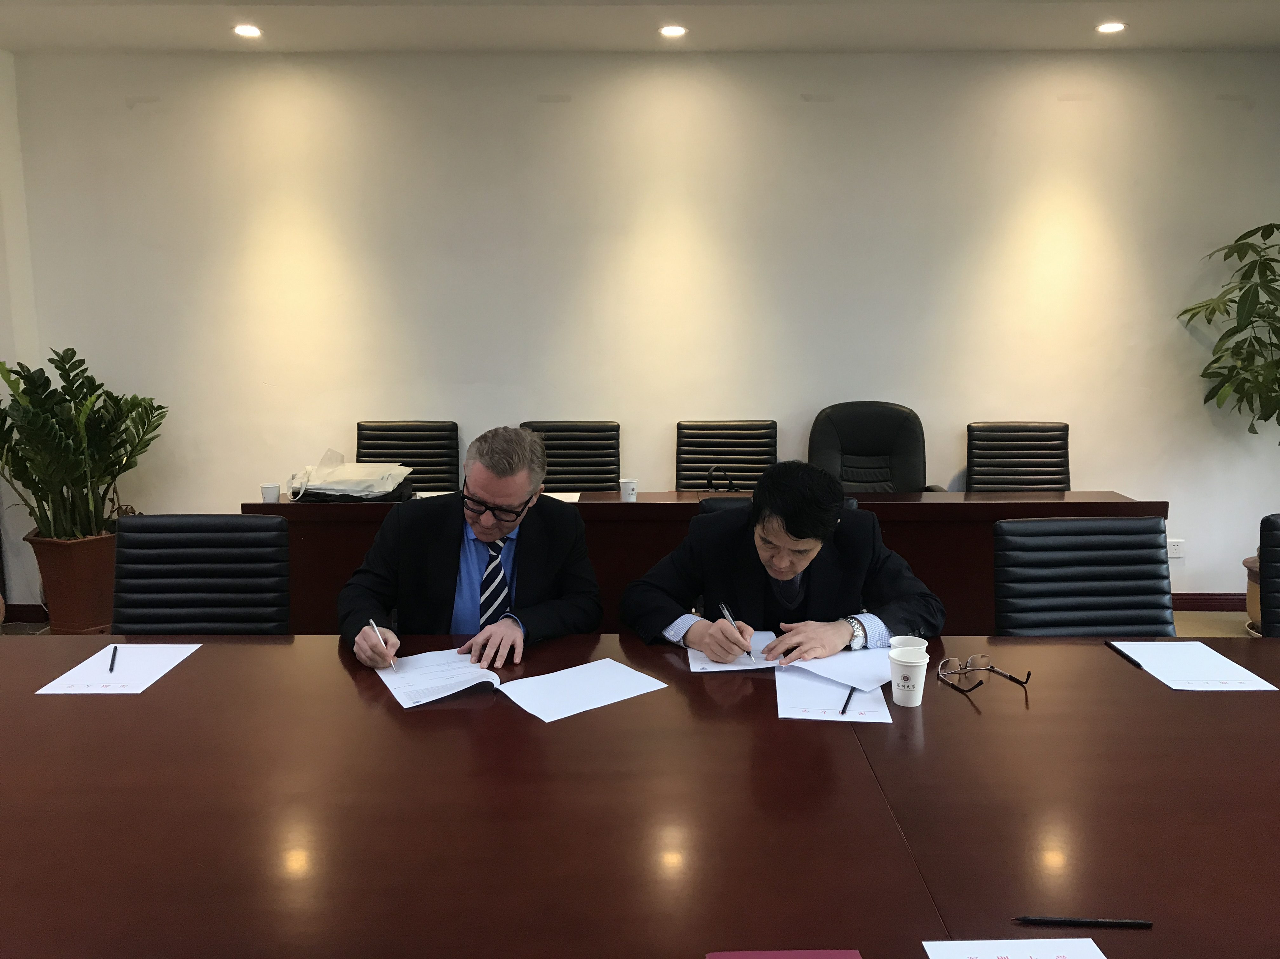
科学研究与技术开发 Scientific Research and Technology Development
组建5-10个研发机构（1个大科学装置）
Establishment of Five to Ten R&D institutions (One Large-scale Scientific Facility)
如：先进材料测试技术研究中心、物联网安全研究中心 、激光智能制造研发中心 、中瑞创新技术研究院等
Such as, Advanced Materials Testing Technology Research Center, Internet of Things Security Research Center, Laser Intelligent Manufacturing R&D Center, China-Switzerland Innovation and Technology Research Institute
成立3-5个产学研中心
Establishment of Three to Five Industry-University-Research Centers
如：大数据及移动互联创新创业中心、激光生物医疗技术应用中心、新型电池材料生产应用示范平台等
Such as, Big Data and Mobile Internet Based Innovation and Entrepreneurship Center, Laser Biomedical Technology Application Center, Demonstration Platform for New Battery Materials Production and Application
成立1-3个技术转移中心
Establishment of One to Three Technology Transfer Centers
探索成立技术转移中心，围绕产业关键技术、核心工艺和共性问题开展协同创新，转化教师技术成果，实现社会效益和经济效益的最大化
SZTU works on the establishment of Technology Transfer Centers, which center around key technologies, core processes and common problems of the industry, so as to transform the technological achievements by SZTU teachers, and maximize social and economic benefits.

Slide 7
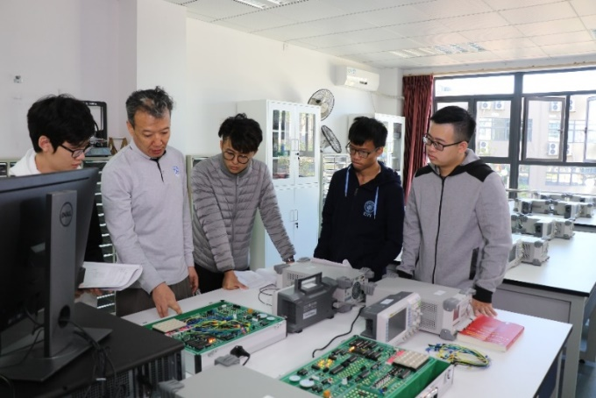
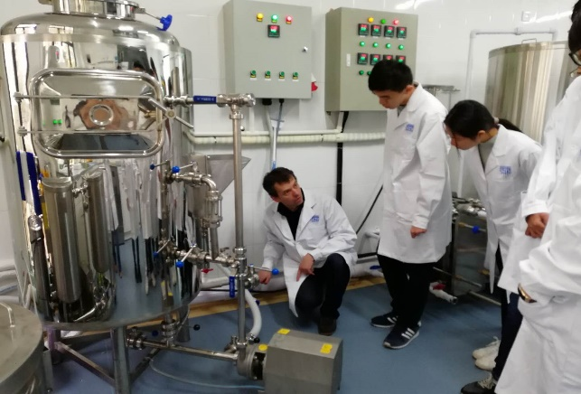
科技创新 Science and Technology Innovation
学校每年设立相应的配套经费，支持教授带领学生开展自主研发项目；从学习之初便开始培养学生的动手能力，为培养综合素质过硬的应用型人才夯实基础。
Each year, SZTU sets up corresponding funding to support professors to guide students to carry out independent research and projects. From the beginning of the study, students will develop their hands-on ability, which lays a solid foundation for the cultivation of comprehensive quality talents.

Slide 8
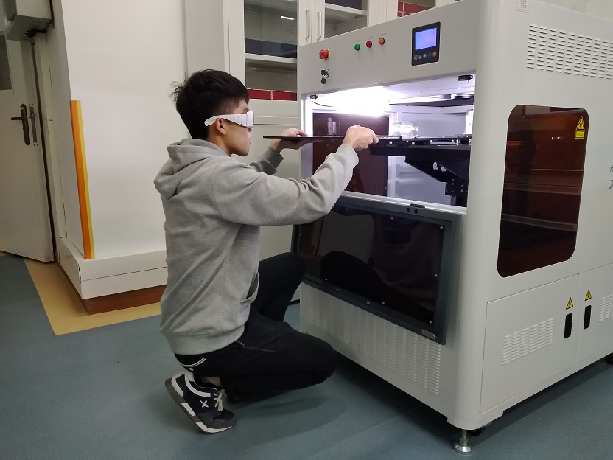
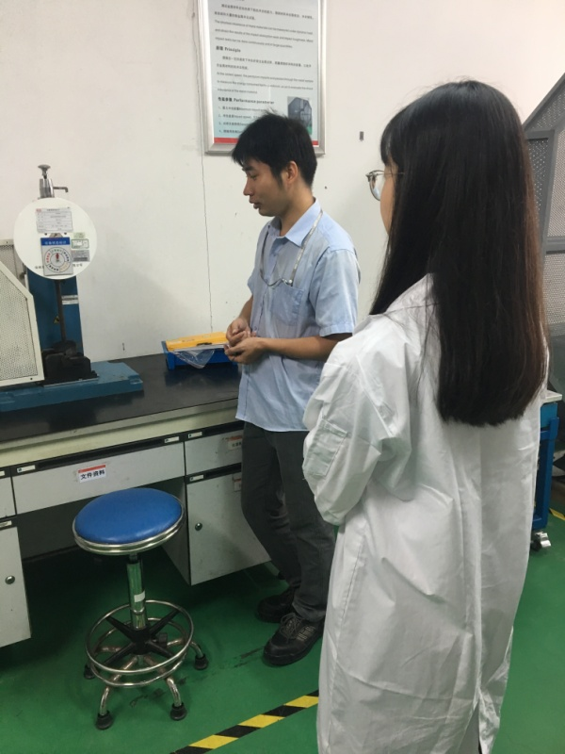
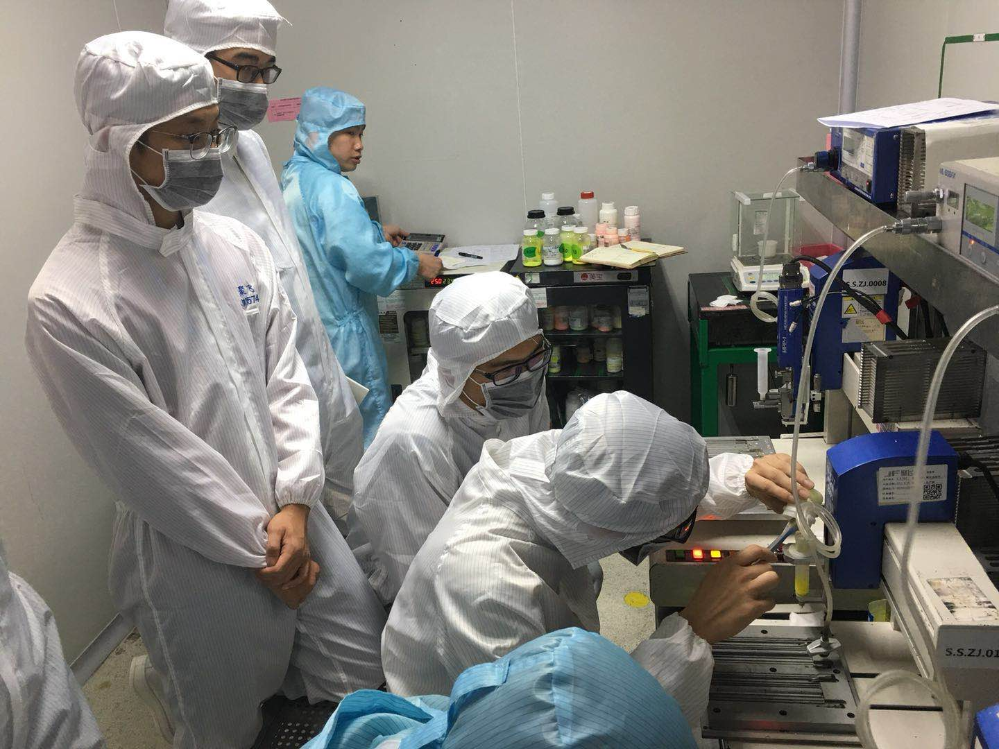
科技创新 Science and Technology Innovation
校企合作研发：教授带领学生参与校企合作研发项目；企业与学校各提供一部分经费用于研发项目。
University-Enterprise Cooperative Research: Professors lead students to participate in university-enterprise cooperative research and development projects; enterprises and university respectively provide a portion of funds for research and development projects.

Slide 9
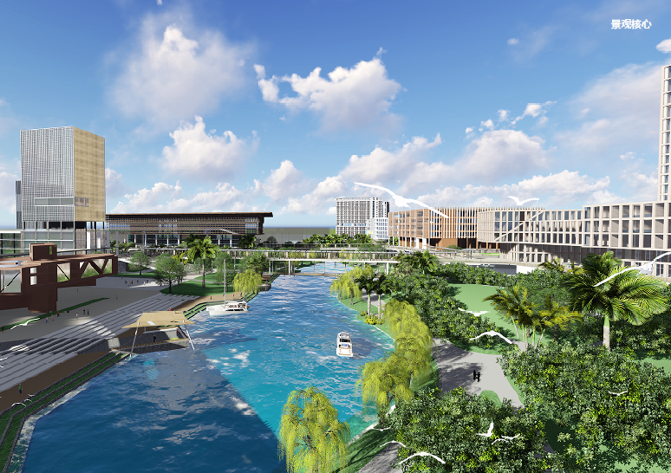
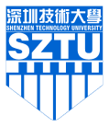
谢 谢！
Thank you!

